Slide 1
Diode Model
EE101: Lecture 3

Slide 2
Contents :
7. I-V Characteristics of a Diode
8. Two types of reverse breakdown of a Diode
9. Two Models of a Diode
10. Examples: Analysis of simple circuits using the models

Slide 3
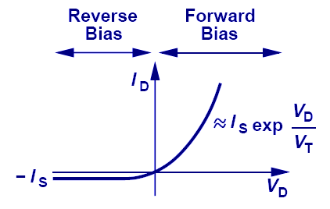
7. I-V Characteristic of PN Junction
The current and voltage relationship of a PN junction is exponential in forward bias region, and relatively constant in reverse bias region.

Slide 4
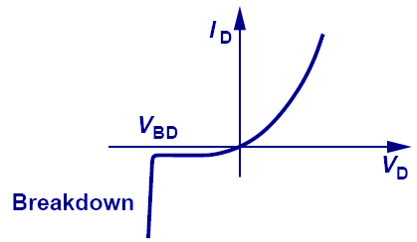
8. Reverse Breakdown
When a large reverse bias voltage is applied, breakdown occurs and an enormous current flows through the diode.

Slide 5
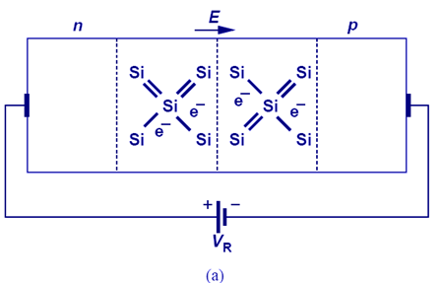
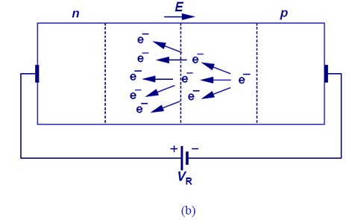
8.1 Zener vs. Avalanche Breakdown
Zener breakdown is a result of the large electric field inside the depletion region that breaks electrons or holes off their covalent bonds.
Avalanche breakdown is a result of electrons or holes colliding with the fixed ions inside the depletion region.

Slide 6
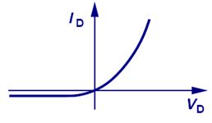
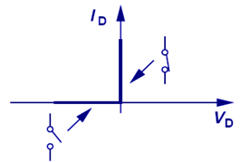
9.1 Two Models for a Diode – Ideal Switch Model
Approximated to
The Simplest model of the actual diode is an ideal switch (For interpreting the model, take the diode oriented vertically, as shown above)

Slide 7
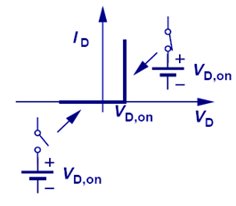
9.2 Two Models for a Diode – Voltage Source in series with a Switch Model
Approximated to
The next simple model of the actual diode is an ideal switch in series with a voltage source. (For interpreting the model, take the diode oriented vertically, as shown above)

Slide 8
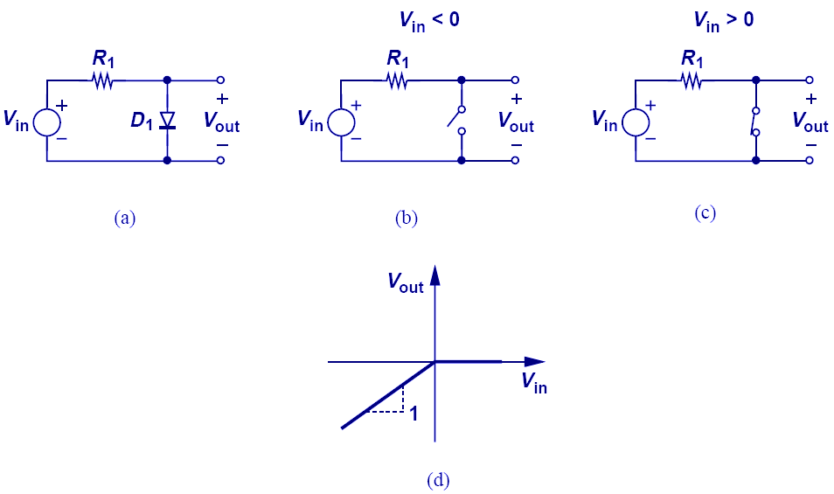
10.1 Example: Input/Output Characteristics
When V_{in} is less than zero, the diode opens, so V_{out} = V_{in}.
When V_{in} is greater than zero, the diode shorts, so V_{out} = 0.

Slide 9
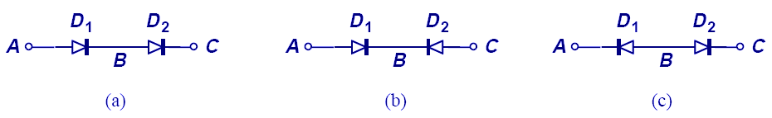
10.2 Diodes in Series
Diodes cannot be connected in series randomly. For the circuits above, only a) can conduct current from A to C.

Slide 10
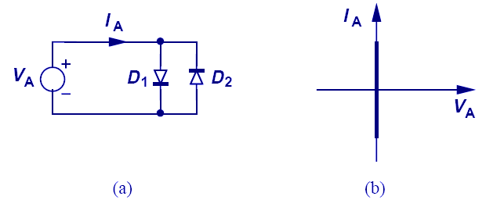
10.3 Anti-Parallel Ideal Diodes
If two diodes are connected in anti-parallel, it acts as a short for all voltages.

Slide 11
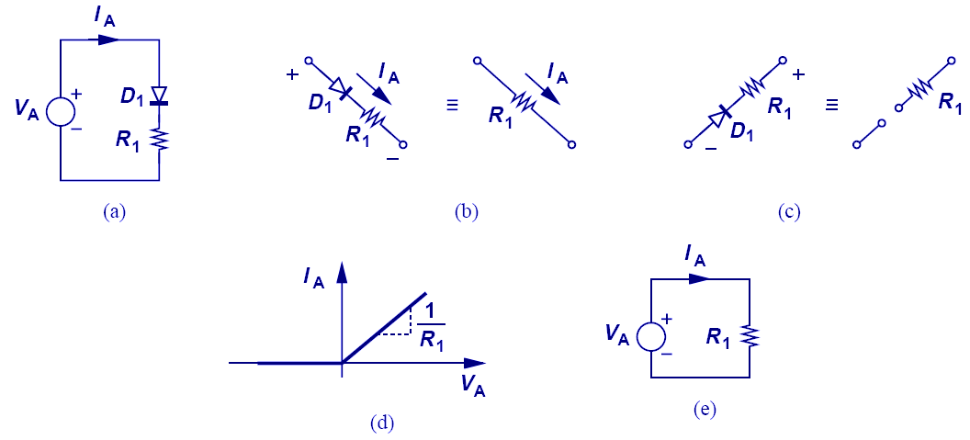
10.4 Diode-Resistor Combination
The IV characteristic of this diode-resistor combination is zero for negative voltages and Ohm’s law for positive voltages.

Slide 12
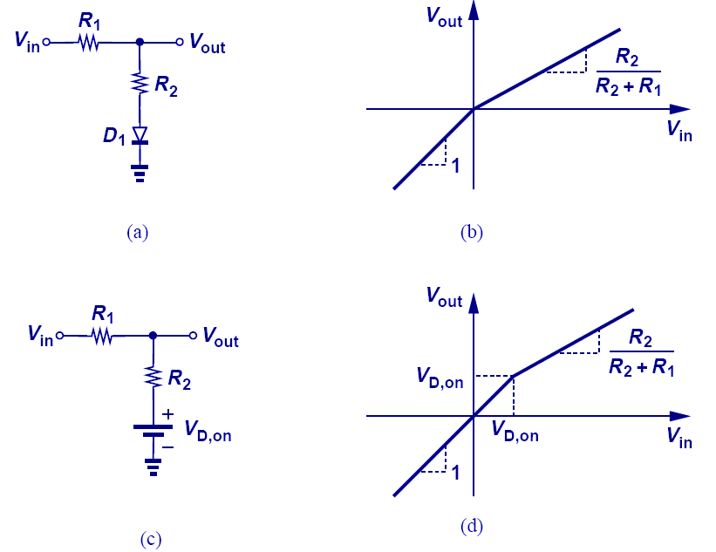
10.5 Input/Output Characteristics with Ideal and Constant-Voltage Models
The circuit above shows the difference between the ideal and constant-voltage model; the two models yield two different break points of slope.

Slide 13
Reference
Fundamentals of Microelectronics by Behzad Razavi, Ch2 and Ch3

